Slide 1
Snowflake Cortex Search
RAG-Based Document Question Answering Application
Project Overview • Architecture • Workflow • Evaluation
Presented by: Mummana Venkatesh
Snowflake Cortex Search RAG Application | 1

Slide 2
1. Overall View
Builds a question-answering assistant that uses information from a selected set of documents.
Uses Retrieval-Augmented Generation (RAG): retrieve relevant text first, then generate an answer using an LLM.
Snowflake stores and processes document text; Cortex Search retrieves relevant passages.
A language model uses the retrieved passages and user question to formulate a natural-language response.
Streamlit provides a simple interface for users to submit questions and view answers.
Snowflake Cortex Search RAG Application | 2

Slide 3
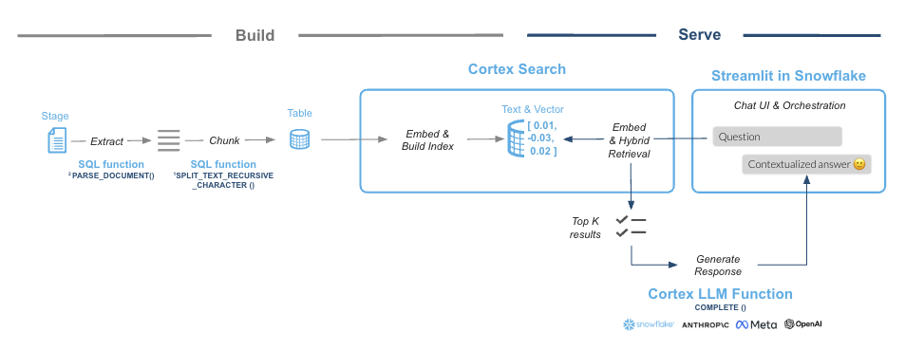
2. Architecture
Main components and their responsibilities
Documents
PDF manuals / knowledge files
Input source
Snowflake Stage + SQL
Store files, extract text,
prepare searchable chunks
Cortex Search
Find relevant document
passages for a question
LLM
Use question + retrieved context
to generate an answer
Streamlit UI
Question input → call retrieval / LLM logic → display answer
Snowflake Cortex Search RAG Application | 3

Slide 4
3. End-to-End Flow
From source documents to a user-facing answer
1. Upload PDFs
Stage
2. Extract text
Document parsing
3. Split into chunks
Text preparation
4. Index/search
Cortex Search
8. Display response
Streamlit
7. Generate answer
LLM
6. Retrieve context
Relevant passages
5. Ask a question
User input
At question time: user question → retrieve relevant chunks → provide context to the LLM → show the generated response.
Snowflake Cortex Search RAG Application | 4

Slide 5
4. Input and Output
Leave Management project: employee leave and holiday questions
Inputs
• Employee question (e.g., “How many leave days do I have left?”)
• Employee identity / company email and role
• Leave balance, leave history/status, and holiday data retrieved from Snowflake
Outputs
• Employee-specific leave balance and remaining days
• Leave history with dates and approval status
• Public holiday dates listed directly in the chat response (not as a file)
Example
Question: “Show me my remaining leave balance and upcoming public holidays.”
Answer: “Your leave balance and upcoming public holidays are listed below…” followed by the relevant details from the configured project data.
Snowflake Cortex Search RAG Application | 5

Slide 6
5. Evaluation / Metrics
Validation summary — sample Leave Management scenarios tested
Retrieval relevance: Tested sample questions and checked that relevant leave or holiday information is retrieved.
Answer correctness: Responses were checked against the configured project data.
Groundedness: Answers are based on retrieved information rather than unsupported guesses.
Response time: The application returned responses during the validation checks.
Coverage: Tested leave-balance and public-holiday questions; responses worked as expected for the configured scenarios.
Validation outcome
Sample Leave Management questions have been tested, and the application is working as expected for the configured data and scenarios.
Snowflake Cortex Search RAG Application | 6

Slide 7
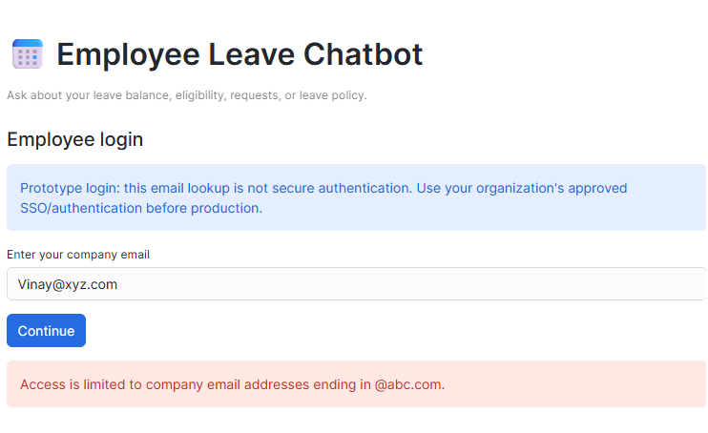
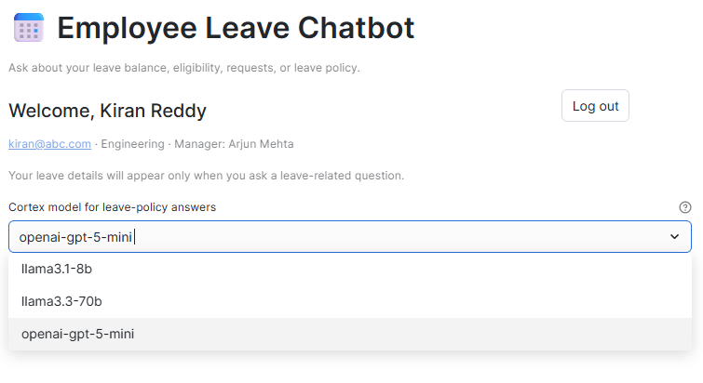
Input and output results
Example
Question: Requester with incorrect email address trying to access chatbot
Answer: chatbot gives error that only employees of abc company can access
Example
After employee successful logged in chat bot gives employee details like name, department and manager details. Additional we have added 5 models that user can select for querying their request
Snowflake Cortex Search RAG Application | 6

Slide 8
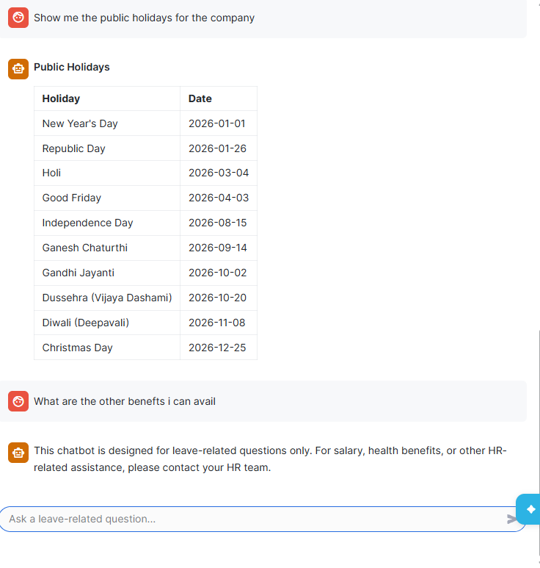
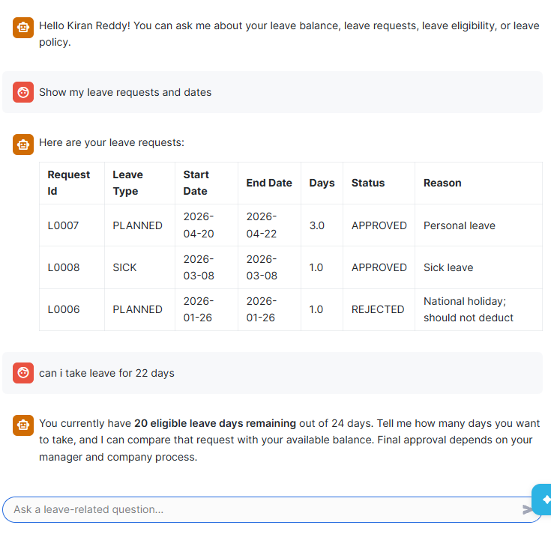
Input and output results
Example
Question: Employee can ask about their leave summary details and pending available leave details
Example
Question: User can also request their public holidays details.
Snowflake Cortex Search RAG Application | 6

Slide 9
6. Inferences
What the design is intended to demonstrate
Retrieval helps connect an LLM to organization-specific document content.
Chunking allows large documents to be searched in smaller, relevant sections.
Separating retrieval from generation makes the workflow easier to understand and evaluate.
Answer quality depends on document quality, chunking, search relevance, and prompt design.
The approach can be adapted to knowledge bases such as product manuals, FAQs, or policy documents.
Snowflake Cortex Search RAG Application | 7

Slide 10
Conclusion
Key takeaways
Cortex Search retrieves relevant passages; an LLM uses that context to generate natural-language answers.
The Streamlit interface lets users ask questions and view responses.
The Leave Management application supports configured leave-related questions and public-holiday queries, with access governed by the configured roles.
Validation completed: sample questions were tested, and the application is working as expected for the configured scenarios.
Snowflake Cortex Search RAG Application | 9

